Slide 1
Basic Models and Tools
Lecture 1
Discrete Mathematical Structures

Slide 2
Basic Models and Tools
Part I: Sets, Sequences and Structures
  Sets: fundamental model in mathematics
  Sequences: elements and order
  Structures: sets with operations
Part II: Some Useful Tools
  Division, prime and algorithm
  Matrices and operations on them

Slide 3



Scenario
abstraction
Problem
Abstraction
System Abstraction
Data
Abstraction
Real world
Computer implementation

Slide 4


Modeling the Real World
the Structure
Operator - Relation
Discrete Objects - Elements
......
the Set

Slide 5

What We Look at
Structures in General
Specific Structures
Details of Obs & Ops

Slide 6
Discrete Math Model – an Example
Two-player game using 9 matched
  The player takes one, or two, or three matches in turn, and cannot take the same number as the another player took in the last run.
  If both are clever enough, the one who take the first must win.
  A more general problem: how many matches can guarantee the first player’s winning.
  Model:
    ”pattern” : a triple (X, m, k) , X is the next player，the nonnegative integer m is the number of matches left, (m≤n)，k is the number of matches another player took in the last run. It is easy to see that both (X, 0, k) and (X, 1, 1) are “lose pattern)
    “move”: three functions: f_{1,} f_{2,} and f_{3,} f_{i}(X, m, k)=(another play, m-i, i），f_{i} is not defined on (X, m, i).
  For player X, both (X, 4, k) and (X, 8, k) are “lose pattern)
  Can you prove a generalized result?

Slide 7
Concept of Set
No exact definition
  a variety of different objects as being bound together by some common property, the property may be nothing more than the ability to think of these objects (as being) together
  Description by Cantor：A set is a collection into a whole of definite, distinct objects of our intuition or our thought. The objects are called elements (member) of the set.

Slide 8
Representation of Set
{x | P(x)}, P must be a mathematically definite property
  “There exists no Y∈X” is a well-defined property about X
  “For every U, U∈Z iff. U∈X and U∈Y” is a well-defined property about X, Y and Z。
There may be more than one representation for one set:
  {2, 3, 5}
  All prime numbers in [1, 7)
  All real roots of the equation x³-10x²+31x-30=0。

Slide 9
Subset
“is a subset of” is a relation between two sets:
  A⊆B is defined as: For all x∈A, x∈B
  So, A⊄B means that: There exists at least an x, satisfying x∈A, but x∉B

Slide 10
Equality of Sets
Two sets A,B are equal (A=B) if they have the same elements.
For any two sets A,B, A=B if and only if:
  A⊆B, and
  B⊆A

Slide 11
Empty Set
A set without any element in it.
  Ex. A={x|x is a integer and x>x}
Empty set is a subset of any set.
  If A is an empty set, and B is a set. The statement “there exists an element x, satisfying x∈A, but x∉B” is always false.
There is a unique empty set, denoted as Ø
  If there are two empty sets Ø₁, Ø₂, then both Ø₁⊆Ø₂ and Ø₂⊆Ø₁ are true.

Slide 12
Power Set
ρ(A)={x|x⊆A}, where A is a set.
ρ({a,b}) = {Ø,{a},{b},{a,b}}
ρ(Ø) = {Ø}
If |A|=n, then |ρ(A)|=2^{n}
  So, another denotation for power set: 2^{A}

Slide 13
Fundamental Set Operations
Union and intersection
  A∪B={x|x∈A or x∈B}
  A∩B={x|x∈A and x∈B}
Complement with respect to a given set
  A-B={x|x∈A and x∉B} = A∩~B
  Complement(with respect to a universal set)
Symmetric difference
  A⊕B = (A-B)∪(B-A)

Slide 14
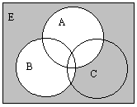
Venn’s Digram: Example 1
~A∩ ~B

Slide 15
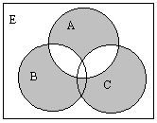
Venn’s Digram：Example 2
(A-(B∪C))∪((B∪C)-A)

Slide 16
Properties of Set Operations （1）
Least upper bound and greatest lower bound under inclusion relation
  A⊆A∪B, B⊆A∪B
  For any X，if A⊆ X , B⊆ X , then A∪B⊆ X
  A∩B⊆A, A∩B⊆B
  For any X，if X ⊆ A , X ⊆ B , then X⊆ A∩B

Slide 17
Properties of Set Operations （2）
Subset relation and set operations
  A∪B=B ⇔
  A⊆B ⇔
  A∩B=A ⇔
  A-B=φ

Slide 18
Properties of Set Operations（3）
Properties of Union and Intersection
  Idempotent properties
  Associative properties
  Commutative properties
  Distributive properties
  Properties related to empty and universal set
  Properties related to complement
  Absorptive properties
  de Morgan’s Law

Slide 19
Properties of Set Operations（4）
Properties of the relative complement
  A-B⊆A
  A-B=A∩∼B

Slide 20
Properties of Set Operations（5）
Properties of the symmetric difference
  Commutation and Association
  Idempotention
  A⊕A= φ
  Cancellation

Slide 21
True or False?
✗
✓
✓
✓
✗
✗
✗
✓
✗
✓
(1) A∈{{A}}
(2) {A}∈{{A}}
(3) x∈{x}-{{x}}
(4) {x}⊆{x}-{{x}}
(5) A-B=A⇔B=Ø
(6) A-B=Ø⇔A=B
(7) A⊕A=A
(8) A-(B∪C)=(A-B)∩(A-C)
(9) If A∩B=B, then A=E
(10) A={x}∪x, then x∈A and x⊆A

Slide 22
How to Prove（1）
Using definitions of equality or inclusion
  Ex：A∪B=B ⇒ A⊆B
    Prove “For any x, if x∈A, then x∈B”
  Ex：A⊆B ⇒ A∩B=A
    Prove both:
    “For any x, if x∈A∩B, then x∈A”
    “For any x, if x∈A, then x∈A∩B”

Slide 23
How to Prove（2）
Using definition of operations
  Ex：A-(B∪C) = (A-B) ∩ (A-C)
  A-(B∪C)={x|x∈A, but x∉B∪C)
  ={x| x∈A, but (x∉B and x∉C)}
  ={x| (x∈A, but x∉B) and (x∈A, but x∉C)}
  = (A-B) ∩ (A-C)

Slide 24
How to prove（3）
A∩B=A⇒A-B=φ:
A-B = A∩∼B
= (A∩∼B)∪(A∩∼A)
= A∩(∼B∪∼A)
= A∩∼(A∩B) = A∩∼A = φ
A-B=φ⇒A∩B=A:
A∩B=(A∩B)∪(A∩∼B)
=A∩(B∪∼B)=A∩E=A
Algebraic reduction using known equalities
  Ex：A∩B=A ⇔ A-B=φ
  Ex：A∪(A∩B) = A
  Ex：If A⊕B=A⊕C, prove B=C
  A more complicated example：
    Using A ∩ B=A ⇔ A⊆B to prove：
    ((A∪B∪C) ∩ (A∪B))-((A∪(B-C)) ∩A)=B-A
(A∪B∪C) ∩ (A∪B)= (A∪B)
(A∪(B-C)) ∩A)=A, so (A∪B)-A=B-A

Slide 25
How to prove（4）
Prove a sequence of logically equivalent expression
  A∪B=B ⇔ A⊆B ⇔ A∩B=A ⇔ A-B=φ，
    Using the results above, we only need prove A-B=φ ⇒ A∪B=B。
    Note：A∪B= (A∪B) ∩E=(A∪B) ∩(∼B∪B)

Slide 26
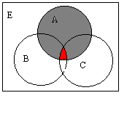
More about Venn’s Diagram
Venn’s digram and proof
Ex：
  Give the condition for
  (A-B)∪(A-C)=A
    the sufficient and
    necessary condition
    is preferred
  A∩B∩C=φ

Slide 27
Counting for Finite Sets
Addition Principle (inclusion-exclusion principle)
  Two sets
    |A∪B| = |A|+|B|-|A∩B|
  Three sets
    |A∪B∪C| = |A|+|B|+|C|-|A∩B|-|A∩C|-|B∩C|+| A∩B∩C|

Slide 28
Using Addition Principle
Among 260 students，64 select Math，94 select Computing，58 select Finance，28 select both Math and Finance，26 select both Math and Computing，22 select both Computing and Finance，14 select all three.
Problem: How many select none, and how many select only one course?

Slide 29
Solution
Addition principle
|M∪C∪F|=|M|+|C|+|F|-|M∩F|-|M∩C|-|C∩F|+ |M∩C∩F|
=64+94+58-28-26-22+14
=154
So, 106 select none.
106
M
24
12
14
14
60
8
22
C
F

Slide 30
Generalized Union and Intersection
Generalized union
  ∪A = {x|exists some z∈A,such that x∈z}
Generalized intersection
  ∩A = {x|for any z, if z∈A, then x∈z}

Slide 31
Examples on the Set of Real Number
Generalized union
  A₀={a|a<1}，A_{i}={a|a≤1-1/i}, then: ∪{A_{i}|i=1,2,3,…} = A₀
Generalized intersection
  B₀={b|b≤1}，B_{i}={b|b<1+1/i}, then: ∩{B_{i}|i=1,2,3,…} = B₀

Slide 32

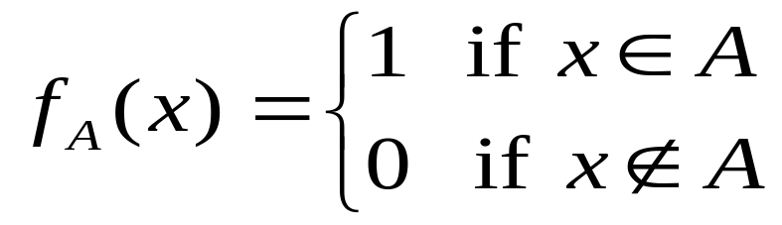
Inside or Outside
Characteristic Functions
Examples:
  A={1,2}; f_{A}(x)=1-|sign((x-1)(x-2))|
For any subset A of a universal set U

Slide 33
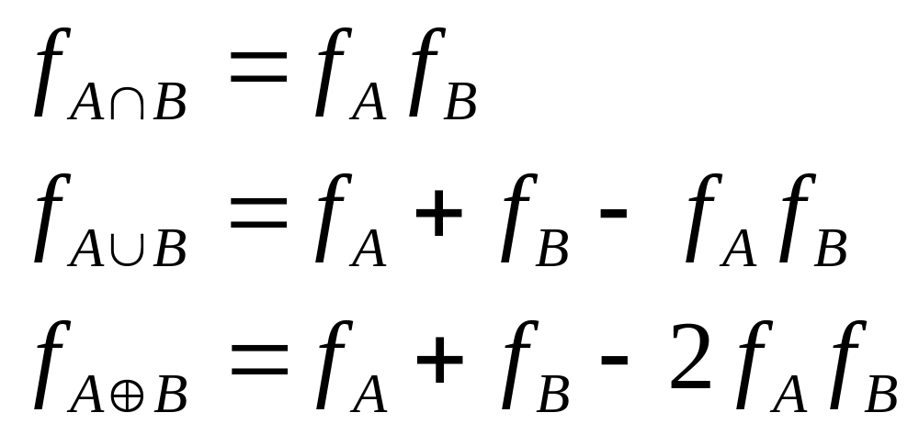

Characteristic Functions and Set Operations
Both
Either
Either, but not Both
What about f_{A-B} ?

Slide 34
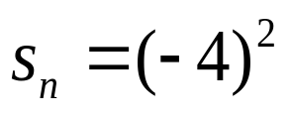
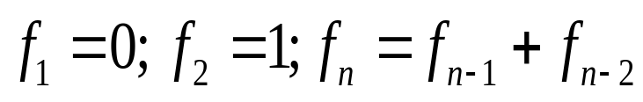
With Ordering Added
Sequence
  A list of objects arranged in a definite order
The ordering number can be looked as a integral part of the object
Defining a sequence by formular
  By explicit formular:
  By recursive formula:

Slide 35
String – Sequence of symbols
Alphabet
  A set of symbols, usually finite, such as A={a,b,c}
Word (string)
  A finite sequence of elements of the alphabet, such as ‘bcaabbcca’
  A string of length zero is defined: Λ
All words on A consists the set A*
Defining an operation on A*: ‘·’(catenation)
  w₁·w₂ is just a longer string with w₂ following w₁

Slide 36
Regular Expression
The regular expression over an alphabet A is defined as following:
  RE1. the symbol Λ is a regular expression
  RE2. for any symbol x in A, x is a regular expression
  RE3. If α,β are regular expressions, then αβ is
  RE4. If α,β are regular expressions, then α∨β is
  RE5. If α are regular expressions, then (α)* is

Slide 37
Defining a Language
Given an alphabet A, a subset of A* is a language over A*
With each regular expression over A, there is a corresponding subset of A*. So, we can define a (regular) language with a specific regular expression

Slide 38
Examples of Regular Languages
Let the alphabet be A={0,1}
  0*(0∨1)*:
  Simply the A* itself
  00*(0∨1)*1:
  Beginning with a “0”, and ended with a “1”
  (01)*(01∨1*):
    Note: (01∨1*) corresponds to {01, 1,11,111,1111,...}

Slide 39
Structures in General
Discrete mathematical structures, or systems
  A collection of objects: the set
  One or more operations defined on the set
  The accompanying properties
    Properties most commonly discussed:
    closure
    commutative, associative, distributive
    identity and inverse

Slide 40
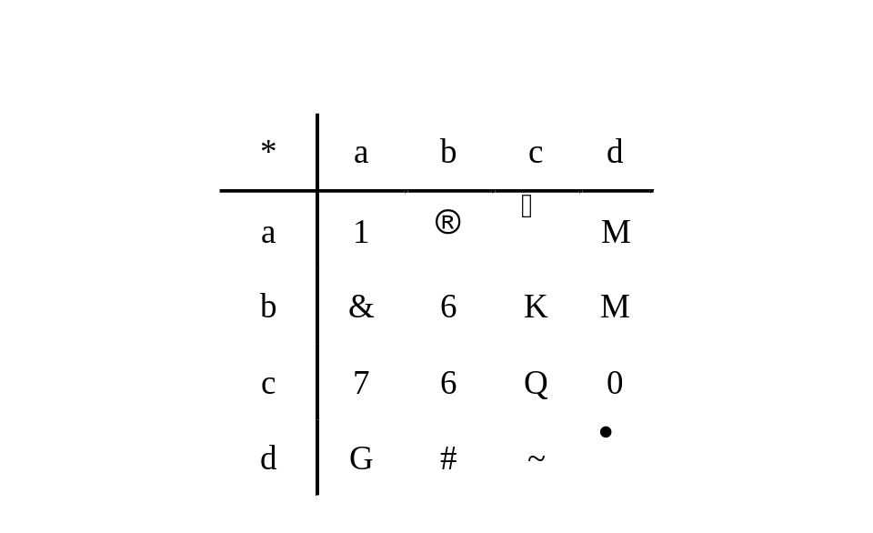
Operation Table
Operation table can be used to define unary or binary operations on a finite set (usually only with several elements)

Slide 41
Closed Operations
A structure is closed with respect to an operation if that operation always produces another member of the collection of object.
Arithmatic operations on sets of numbers
Set A={1,2,3,…,10}, gcd is closed, but lcm is not.
Is the common addition closed on the following set:
    {n | there exists a positive integer k, such that 16|n^{k}}
    {n | 9 divides 21n}

Slide 42
Identity
1*x=x*1=x for any real number x, (* is the common multiplication)
If, in a structure with a binary operation , there is a specific element e, satisfying xe=ex=x for any x in the collection, then e is called an identity.
In fact, such e is unique in the structure

Slide 43
Inverse
In the set of positive real number, for any x, there is an element x’, satisfying x*x’=1, the identity. (x’ is 1/x)
If a binary operation has an identity e, we say y is a -inverse of x if x y=y x=e
If fact, if is associative, and x has a -inverse y, then y is unique
  Suppose x has two -inverse, say, y and z, then
  y = ey = (zx)y = z(xy) = ze = z

Slide 44
Details about Integer Division
If n and m are integers and n>0, we can write m=qn+r for uniquely determined integers q and r with 0≤r≤n.
“n divedes m” is a relation on integers
  If a|b and a|c, then a|(mb+nc) for any integers m,n
Prime number

Slide 45
Greatest Common Divisor(GCD)
If d is GCD(a,b), then d=sa+tb for some integer s and t
  Let x be the smallest positive integer that can be written as sa+tb. For any common divisor c of a,b, c|(sa+tb), which means that x is no less than any common divisor of a,b.
  Let a=qx+r (r<x), then r = a-q(sa+tb) = (1-qs)a-qtb. Since r is also of the form of s’a+t’b, r can not be positive, and must be 0. So, a=qx, that is, x|a. Similarly, x|b.
  Conclusion: x=sa+tb is the largest common divisor of a and b. And it is a multiple of any other common divisors.
If a and b are relatively prime, we can always find two integers s,t, satisfying sa+tb=1

Slide 46
Euclidean Algorithm
Euclid (a,b) [a,b are arbitrary nonnegative integers]
  if b=0 then return a
  else Euclid (b, a mod b)
Correctness of Euclid Algorithm
  The algorithm must terminate
  Note: Let a=k₁b+r₁ (that is, r₁ is a mod b), then r₁=a-k₁b. It is easy to see that any common divisor of b,r₁ must divide a, and any common divisor of a,b must divide r₁ as well. So, GCD(a,b)=GCD(b,r₁)

Slide 47
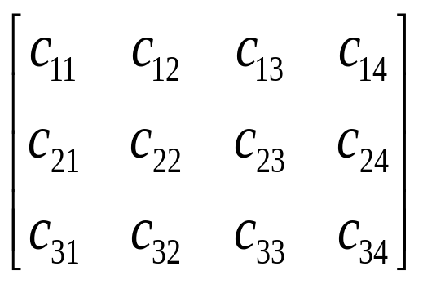
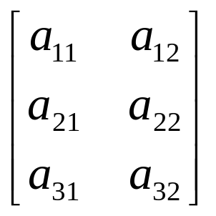
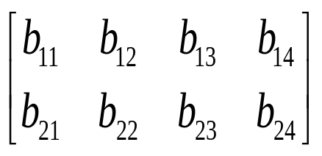
Matrix Multiplication AB=C
×
=
c₂₃=a₂₁b₁₃+a₂₂b₂₃
Generally: c_{ij} = Σ_{k=1,..,k}a_{ik}b_{kj}

Slide 48
Home Assignments
To be checked
  pp.4-5: 5, 10, 16, 30-31, 34, 36
  pp.11-13: 1, 6, 10, 23-24, 34, 36, 39
  pp.19-20: 19, 20, 22, 25, 29, 32, 34, 37
  p.30-31: 24-29
  p.39-41: 6,9, 16, 17, 23, 29, 41
  P.44-45: 24-29, 35
Self tests

